Slide 1
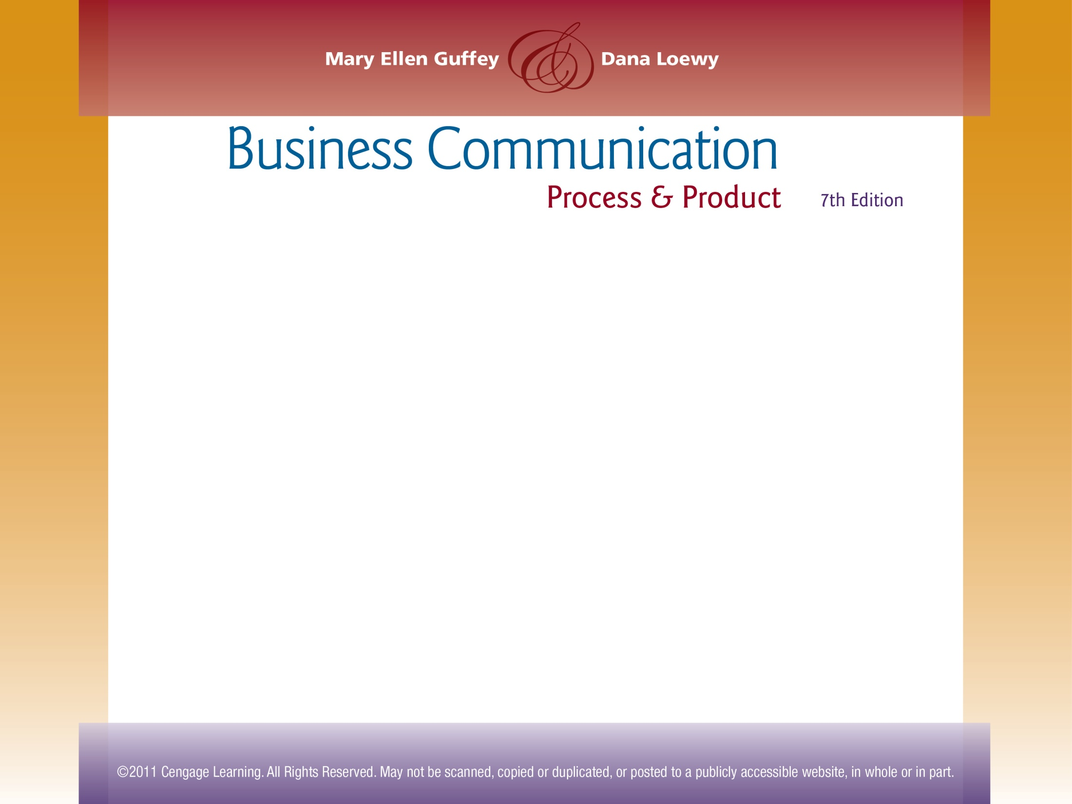

Chapter 6
Revising Business Messages

Slide 2
Topics in This Chapter
Revising Tips
Designing Documents for Readability
How to Proofread Documents
Proofreading Marks for Digital and Hard-Copy Documents
How to Evaluate a Business Message

Slide 3

Revising Tips
Eliminate flabby expressions.
Wordy | Concise
at this point in time | now
due to the fact that | because
in very few cases | seldom
despite the fact that | although
feel free to | please
Notes:
8

Slide 4
Revising Tips
Limit long lead-ins (unnecessary introductory words).
Wordy | Concise
This is to inform you that Monday is a holiday. | Monday is a holiday.
I am writing this letter because Professor John Donnellan suggested that your organization was hiring. | Professor John Donnellan suggested that your organization was hiring.
Notes:
8

Slide 5
Revising Tips
Drop unnecessary opening fillers (there is/are and it is/was beginnings).
Wordy | Concise
There are over 50 visitors who commented on her blog. | Over 50 visitors commented on her blog.
There was an unused computer in the back office. | An unused computer was in the back office.
It is certainly an inspiring sequence of events. | The sequence of events is certainly inspiring.
Notes:
8

Slide 6

Revising Tips
Replace redundancies (expressions that repeat meaning or include unnecessary words).
Redundant | Concise
exact same | exact or same
past history | past or history
serious danger | danger
new innovation | new or innovation
my personal opinion | my opinion
Notes:
8

Slide 7

Revising Tips
Purge empty words.
  In the case of General Motors, the car company was reorganized.
  We are aware of the fact that many managers need assistance.
  When it arrived, I deposited your check immediately. (Obviously, the check arrived.)

Slide 8
Revising Tips
Keep it simple by avoiding indirect and pompous language.
Wordy and Unclear | Clear
It would not be inadvisable for you to affix your signature at this point in time. | You should sign now.
Here are implements that are necessary for the job to be completed in a satisfactory manner. | Here are tools to do the job satisfactorily.
Notes:
8

Slide 9

Revising Tips
Dump trite “business” phrases (worn-out expressions).
Trite | Improved
pursuant to your request | as you requested
please do not hesitate to | please
thank you in advance | thank you
enclosed please find | enclosed
Notes:
8

Slide 10

Revising Tips
Drop clichés (expressions that have become exhausted by overuse), such as
  easier said than done
  first and foremost
  think outside the box
  shoot from the hip

Slide 11
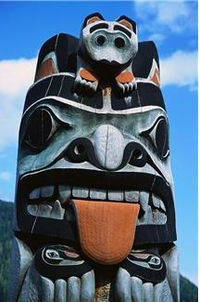
Revising Tips
Drop slang (informal words with arbitrary and extravagantly changed meanings that quickly go out of fashion), such as
  in the pipeline
  down the totem pole
  blowing the budget
  getting burned

Slide 12

Revising Tips
Unbury verbs that are needlessly converted to wordy noun expressions.
Buried Verbs | Unburied Verbs
give consideration to | consider
reach a conclusion that | conclude
create a reduction in | reduce
make a decision about | decide
take action | act
Notes:
8

Slide 13

Revising Tips
Control exuberance (use of intensifiers such as definitely, quite, completely, extremely, really, and totally) to sound businesslike.
Excessive Exuberance | Businesslike
We actually are very sure they do not totally agree with our decision. | We are sure they do not agree with our decision.
Notes:
8

Slide 14

Designing Documents for Readability
Enhance white space by
  Adding headings
  Including bulleted or numbered lists
  Using short sentences
  Writing short paragraph
  Setting effective margins

Slide 15
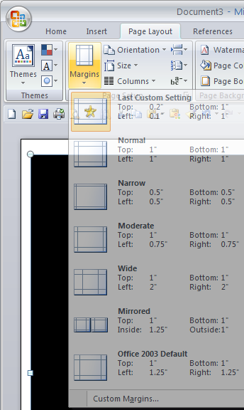
Designing Documents for Readability
Use 1 to 1 ½-inch margins.
How to set margins

Slide 16
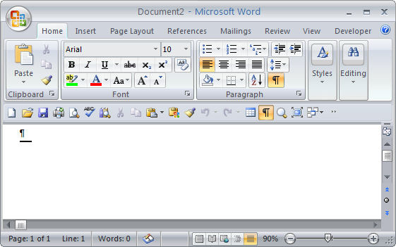
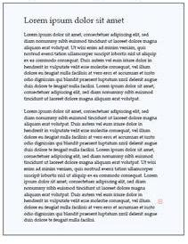
Designing Documents for Readability
Setting for Ragged-Right Margins
Result
Aligns text at left margin and creates a ragged-right margin
Ragged-right margins provide more white space and improve readability.

Slide 17
Designing Documents for Readability
Choose appropriate typefaces.
  Consider sans serif for headings, signs, and material that does not require continuous reading (for example, Arial).
  Consider serif for body font (for example, Times New Roman). Notice that serif typefaces have small features at the ends of strokes.

Slide 18
Designing Documents for Readability
Use 10- to 12-point font for most body text.
For special effects consider:
  CAPITALIZATION
  SMALL CAPS
  Boldface
  Italic
  Underline

Slide 19
Designing Documents for Readability
Use vertical lists or enumerated items within sentences to improve comprehension.
  Use a numbered list for items that represent a sequence or reflect a numbering system; use bullets otherwise.
  Use enumerated items such as (a) and (b) within a sentence.
  Make the lists and enumerated items parallel.

Slide 20
Designing Documents for Readability
Use parallel construction by expressing similar ideas in balanced, matching constructions.
Not Parallel | Parallel
The task force recommends buying a software license, creating software usage policies, and the benefits of the software should be demonstrated. | The task force recommends buying a software license, creating software usage policies, and demonstrating the benefits of the software.
Notes:
8

Slide 21
Designing Documents for Readability
Use numbered lists to show a sequence:
During the hiring process, follow these steps:
  Examine the application.
  Interview the applicant.
  Check the applicant’s references.

Slide 22
Designing Documents for Readability
Use bulleted lists to highlight without necessarily showing a sequence.
Consumers expect the following information at product Web sites:
  Price
  Quality
  Performance
  Availability

Slide 23
Designing Documents for Readability
Add headings for quick comprehension:
  The company needs to focus attention in three key areas:
  Attracting applicants. We need to analyze where and how we advertise for applicants. Specifically, online job boards …
  Interviewing applicants. We should consider adding simulated customer encounters to the process. Simulated …
  Checking references. We should consider contacting all references, not just former employers. Currently, the …

Slide 24
Designing Documents for Readability
Types of headings to consider
Main headings
Subheadings
Category headings

Slide 25
What to Watch for in Proofreading
Proofreading
Names and Numbers
Format
Spelling
Grammar
Punctuation
Notes:
8

Slide 26
How to Proofread Routine Documents
For reading messages on screen
  Use the down arrow to reveal one line at a time.
  Read from a printed copy, to be safer.
In general
  Look for typos, misspellings, and easily confused words.
  Study the document for inconsistencies and ambiguous expressions.
  Look for factual errors.
Notes:
8

Slide 27

How to Proofread Complex Documents
Print a copy, preferably double-spaced.
Set it aside and take a breather.
Allow adequate time for careful proofing.
Expect errors and congratulate yourself when you find them.
Read the message at least twice – once for meaning and once for grammar and mechanics.
Reduce your reading speed and focus on individual words.
Notes:
8

Slide 28
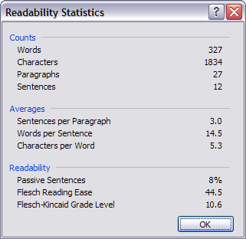
Use Microsoft Word to Help You With Readability and With Proofreading
Comprehension decreases as sentence length increases.
The higher the score, the easier it is to understand the document.
The Flesh-Kincaid Grade Level rates text on a U.S. school grade level.
Source: Microsoft

Slide 29
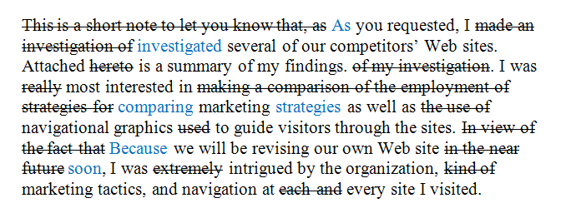
Revised Digital Document Using Strikethrough and Color

Slide 30
Basic Proofreading Marks
Delete
Capitalize
Lowercase (don’t capitalize)
Transpose
Close up

Slide 31
Basic Proofreading Marks
Insert
Insert space
Insert punctuation
Insert period
Start paragraph

Slide 32
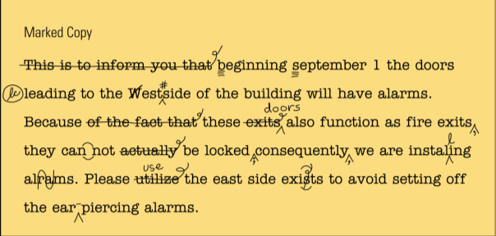
Marked Copy of Printed Document

Slide 33
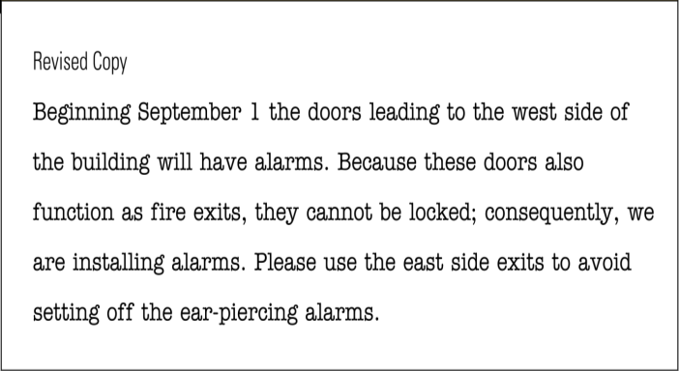
Revised Copy of Printed Document

Slide 34
Evaluating a Business Message
How successful will this communication be?
Does the message say what you want it to say?
Did you encourage feedback so that you will know its success?

Slide 35
End

