Slide 1
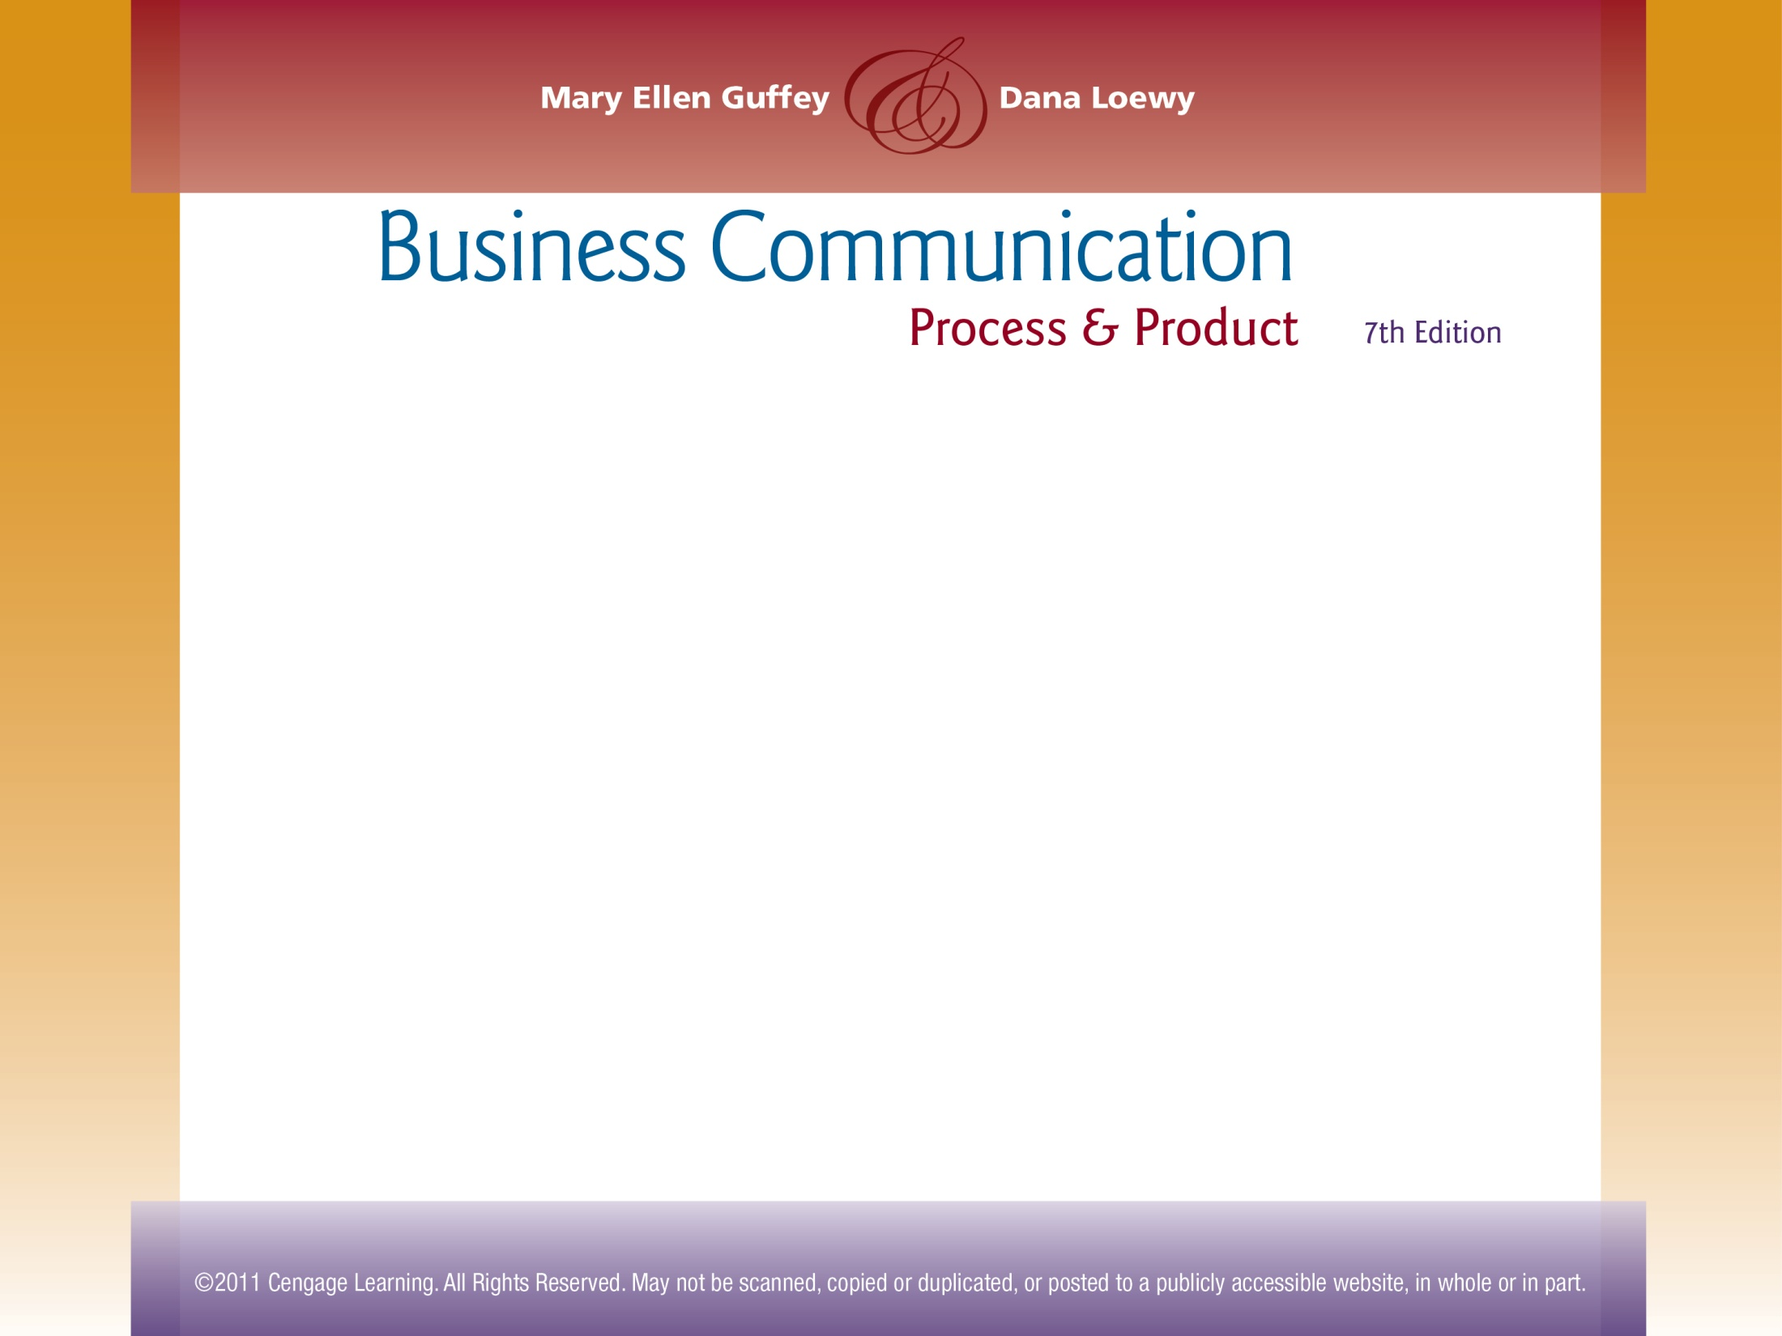
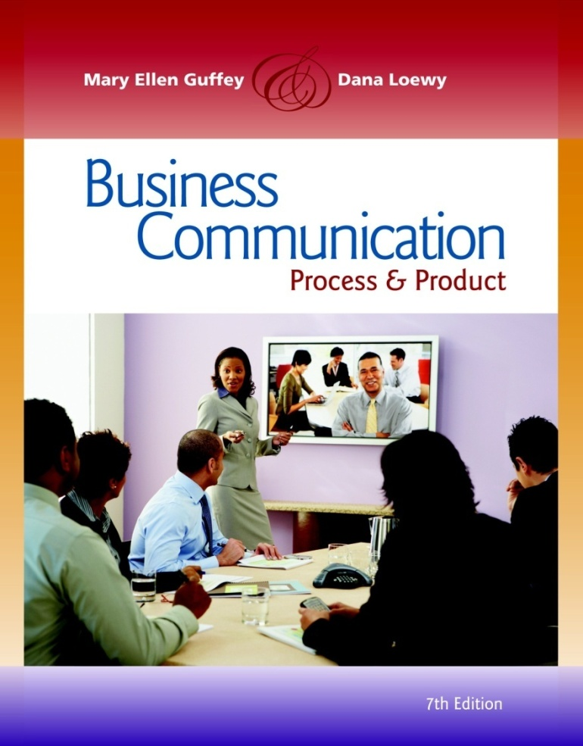
Chapter 8
Positive Messages

Slide 2
Topics in This Chapter
The Writing Process for Positive Messages
Formatting Hard-Copy Memos
Formatting Business Letters
Routine Requests for Information or Action
Direct Response Messages

Slide 3
Topics in This Chapter
Instruction Messages
Direct Claims and Complaints
Adjustment Messages
The Five Ss of Goodwill Messages
Answering Congratulatory Messages

Slide 4
Successful Positive Messages Start
With the Writing Process
Phase 1: Analyze, Anticipate, Adapt
  Do you really need to write?
  How will the reader react?
  What channel should you use?
  How can you save your reader’s time?
1

Slide 5
Successful Positive Messages Start
With the Writing Process
Phase 2: Research, Organize, Compose
  Collect information.
  Choose the best organizational strategy.
  Compose the first draft.
  Group similar information together.
2

Slide 6
Successful Positive Messages Start
With the Writing Process
Phase 3: Revise, Proofread, Evaluate
  Is the message clear? Correct?
  Did you plan for feedback?
  Will this message achieve its purpose?
3

Slide 7
Comparing Typical Positive Messages
E-Mail
Useful for both internal and external communication
Interoffice Memos
Useful for internal messages that require formality or permanent records
Business Letters
Useful for external messages that require a permanent record and confidentiality
Appropriate for short, need-to-know messages, setting up appointments, giving updates, and getting answers to specific questions
Inappropriate for sensitive or confidential issues, building trust, or bonding
Appropriate for delivering instructions, official policies, reports, long documents, and important announcements
Appropriate for conveying formality, sensitivity
Can deliver a persuasive, well-considered message

Slide 8
Formatting Hard-Copy Memos
  MEMORANDUM
  DATE: April 5, 2012
  TO: Dawn Stewart, Manager
  FROM: Jay Murray, Vice President
  SUBJECT: Telephone Service Request Forms
  To speed telephone installation and improve service within the main facility, we are starting a new application procedure.
  Service request forms will be available at various locations within the three buildings. When you require telephone services, pick up a request form at your nearest location. Fill in the pertinent facts, obtain approval from your division head, and send the form to Brent White.
  Please call me at 451-0593 if you have any questions about this new procedure.
Start the dateline 2 inches from the top of the page.
JM
Put sender’s initials here
Align text after guide words
Leave two blank lines between Subject and the first line of the memo.
Single-space within and double-space between paragraphs.
Set side margins at 1 to 11/4 inches.

Slide 9
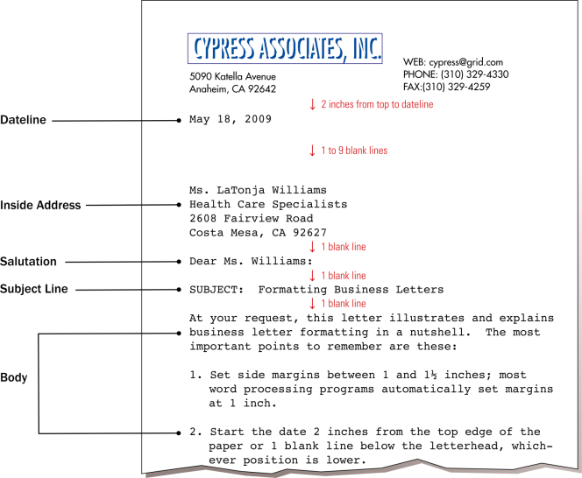
Formatting Business Letters
2012

Slide 10
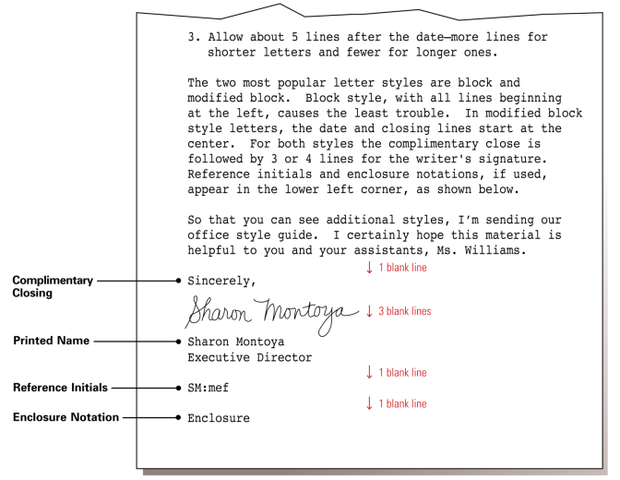
Formatting Business Letters

Slide 11
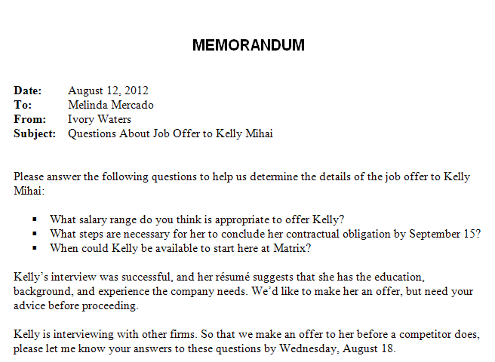
Routine Requests for Information or Action
Opening
  Ask a question or issue a polite command (Please answer the following questions . . .).
  Avoid long explanations preceding main idea.
IW

Slide 12
Routine Requests for Information or Action
Body
  Explain your purpose and provide details.
  Express questions in parallel form. Number or bullet them.
IW

Slide 13
Routine Requests for Information or Action
Body
  Use open-ended questions to elicit the most information (What steps are necessary …?) instead of yes-or-no questions (Can she conclude her contrac-tual obligation … ?).
IW

Slide 14
Routine Requests for Information or Action
Body
  Suggest reader benefits, if possible.
IW

Slide 15
Routine Requests for Information or Action
Closing
  State specifically, but courteously, what action is to be taken.
  Set an end date, if one is significant. Provide a logical reason for the end date.
IW

Slide 16
Routine Requests for Information or Action
Closing
  Avoid cliché endings (Thank you for your cooperation). Show appreciation, but use a fresh expression.
  Make it easy for the receiver to respond.
IW

Slide 17
“Before” – Ineffective Request Memo
  DATE: Current
  TO: Kim Johnson, Corporate Communications
  FROM: Tim Rudolph, CEO
  SUBJECT: New Policy
  This memo is written to inform you that I continue to receive disturbing reports about the misuse of e-mail by employees. In the course of the past three months I have heard of defamatory messages, downloads of pornography for all the staff to see, and even a basketball pool that turned into a gambling operation.
  In view of the foregoing, I am herewith instructing your office that an e-mail policy for the staff is needed. By October 1 a rough draft of a policy should be forthcoming. At the very minimum it should inform each and every employee that e-mail is for business only. Employees must be told that we reserve the right to monitor all messages. No pictures or attachments should be in the e-mail system without there being a valid reason. And we should not be using e-mail to be saying anything about personnel matters—such as performance reviews and salaries.
  If you have any questions, do not hesitate to call.
TR

Slide 18

Memo Revision: Critical Thinking Questions
What is the purpose of the routine request memo on the previous slide?
How effective is the subject line?
Is the opening direct or indirect?
What does the writer want the reader to do?
How should the memo begin?

Slide 19
Memo Revision: Critical Thinking Questions
What information should be included in the body?
What graphic highlighting techniques would improve readability? Revise part of the body to illustrate your recommendation.
What ideas should be included in the closing?
Should a reason be given with an end date?

Slide 20
“After” – Improved Request Memo
  DATE: September 25, 2012
  TO: Kim Johnson, Corporate Communications
  FROM: Tim Rudolph, CEO
  SUBJECT: Developing Staff E-Mail Policy
  Please draft a policy outlining appropriate e-mail use for employees.
  We need such a policy because I have received reports of misuse including defamatory messages, pornography downloads, and even gambling. Here are a few points that the policy should cover:
    E-mail is for business use only.
    E-mail messages may be monitored.
    No pictures or attachments should be sent without a valid reason.
    E-mail should not be used to discuss personnel matters.
  Please submit a draft to me by October 2 because we hope to have a final policy completed by November 5. Call if you have questions.
TR

Slide 21
“Before” – Ineffective Routine Request Letter
  Dear Sir:
  Because we are one of the largest banking systems in the country, we receive hundreds of résumés from job candidates every day. We need help in sorting and ranking candidates by categories, such as job classification, education, work history, skills, and experience.
  Recently, I was reading a Workforce magazine article, and the March issue has a story about your new software program called ResumePro. It sounds fascinating and may be the answer to our problem. We would like more information about this program, which is supposed to read and sort résumés.
  In addition to learning if the program can sort candidates into the categories mentioned earlier, I am wondering if the program can read all the different type fonts and formats that candidates use on their résumés. Another important consideration for us is training and troubleshooting. If we need help with the program, would you supply it?
  Thank you for your cooperation.
  Sincerely,

Slide 22
Letter Revision: Critical Thinking Questions
What is the purpose of the routine request on the previous slide?
What do you think the receiver’s reaction will be to this message?
Should the message be developed directly or indirectly?
How is it currently developed?

Slide 23
Letter Revision: Critical Thinking Questions
What information should be included in the body? How could it be organized for improved readability? Revise part or all of the body.
How could the closing be worded to ensure that you get a response by a specific date? Write an appropriate closing.
How will you know whether the sender has communicated successfully?

Slide 24
“After” – Improved Routine Request Letter
  Dear ResumePro Product Manager:
  Please send me information about your ResumePro software program, which I read about in the March issue of Workforce magazine.
  My company receives hundreds of résumés daily, and, frankly, we need help in processing them. Answers to the following questions would help us determine whether ResumePro could solve our problem.
    1. In terms of fonts and formats, what kinds of résumés can your software program read?
    2. Can the program help us sort and rank candidates by categories such as job classification, education, work history, skills, and experience?
    3. How does your company provide training and trouble-shooting service for your software?
  Thanks for answering these questions and for providing any other information about ResumePro. I would appreciate your response by April 1 so that we can study the program before the rush of job applications in June.
  Sincerely,

Slide 25
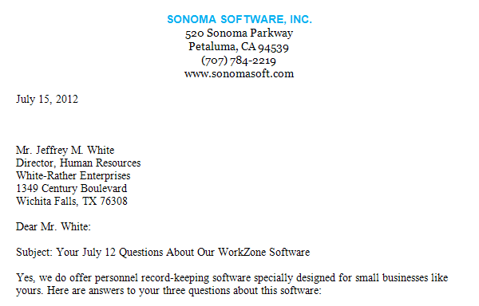
Direct Response Messages
Subject Line
  Identify the topic and any previous correspondence.
  Use abbreviated style, omitting articles (a, an, the).

Slide 26
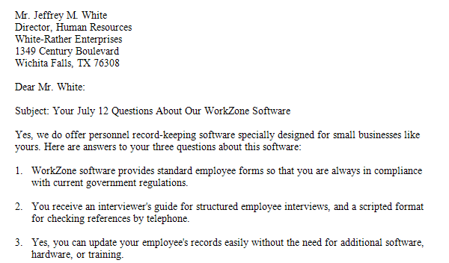
Direct Response Messages
Opening
  Deliver the information the reader wants.
  When announcing good news, do so promptly.

Slide 27
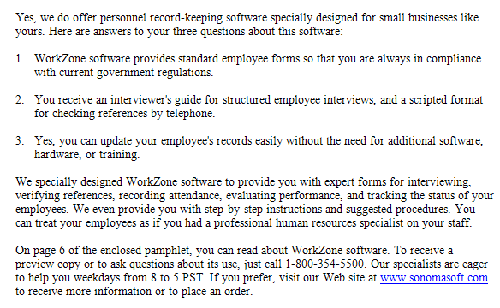
Direct Response Messages
Body
  Explain the subject logically.
  Use lists, tables, headings, boldface, italics, or other graphic devices to improve readability.
  Promote your products and your organization to customers.

Slide 28
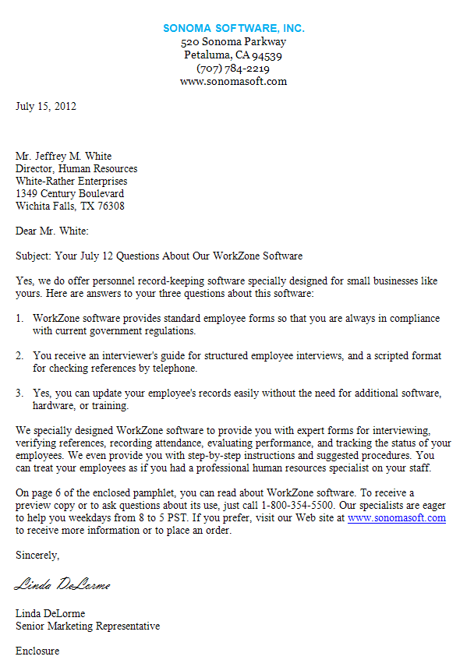
Direct Response Messages
Closing
  Offer a concluding thought, perhaps referring to the information or action requested.
  Avoid cliché endings (If you have any other questions, don’t hesitate to call).
  Be cordial.

Slide 29
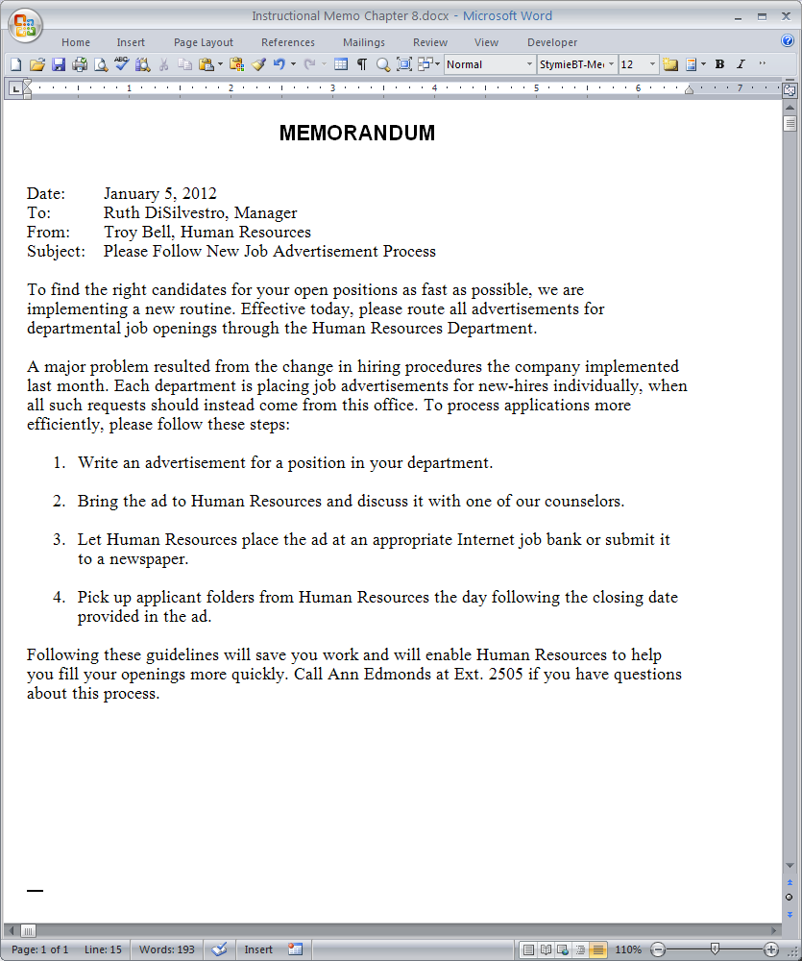
Instruction Messages
Opening
  Introduce the instructions.
  Explain why the instructions are necessary.
TB

Slide 30
Instruction Messages
Body
  Divide the instructions into steps.
  List the steps in the order to be carried out.
  Arrange the items vertically with bullets or numbers.
TB

Slide 31
Instruction Messages
Body
  Begin each step with an action verb. Not this: An advertisement for a position should be written. But this: Write an advertisement for a position.
TB

Slide 32
Instruction Messages
Closing
  Explain how following the instructions will benefit the reader.
  Use a polite, positive tone here and throughout the message.
TB

Slide 33
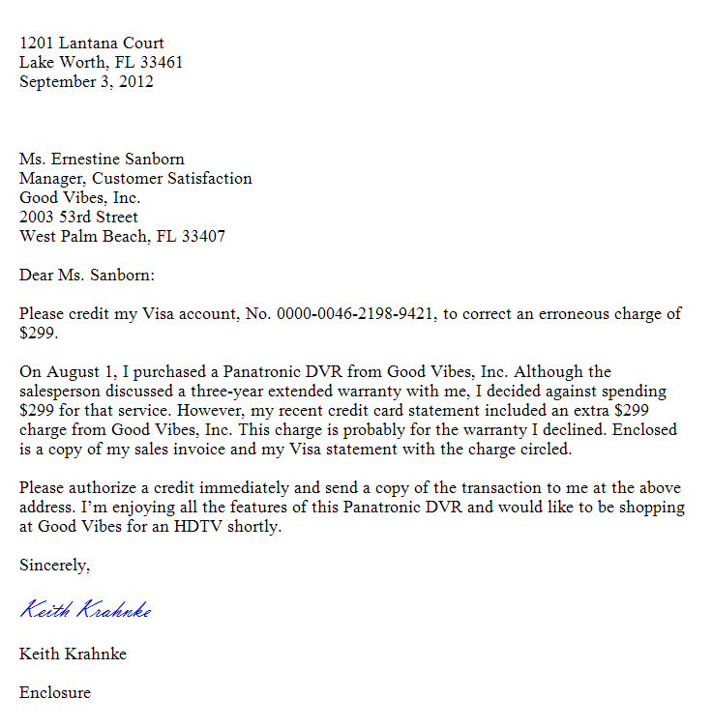
Direct Claims, Complaints
Opening
  Explain immediately what you want done.
  State the remedy briefly when it is obvious (Please credit my Visa account …).
  Explain your goal when the remedy is less obvious.

Slide 34
Direct Claims, Complaints
Body
  Explain the problem and justify your request.
  Provide details objectively and concisely.
  Be organized and coherent. Don’t ramble.

Slide 35
Direct Claims, Complaints
Body
  Avoid becoming angry or trying to fix blame.
  Include names and dates with previous actions.

Slide 36

Direct Claims, Complaints
Act promptly in making claims and always keep a copy of your message.
Closing
  End courteously with a tone that promotes goodwill.
  Request specific action, including end date, if appropriate.

Slide 37
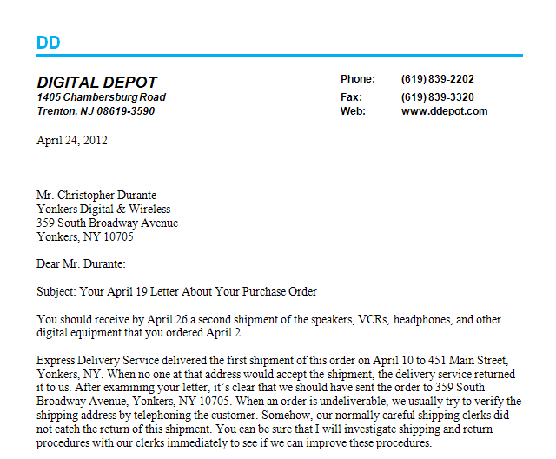
Adjustment Messages
Opening
  When approving a customer’s claim, announce the good news (adjustment) immediately.
  Avoid sounding grudging or reluctant.

Slide 38
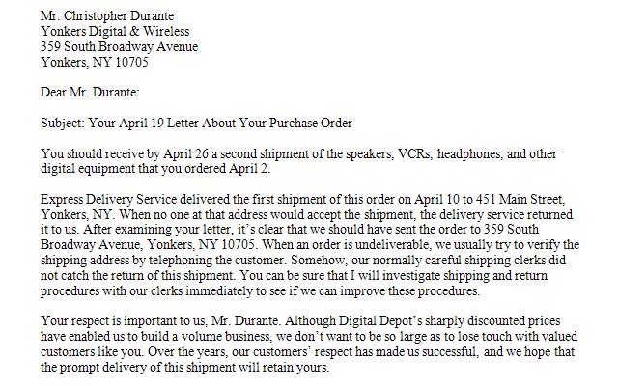
Adjustment Messages
Body
  Strive to win back the customer’s confidence; explain what went wrong (if you know).

Slide 39
Adjustment Messages
Body
  Apologize if it seems appropriate, but be careful about admitting responsibility. Check with your boss or legal counsel first.

Slide 40
Adjustment Messages
Body
  Concentrate on explaining how diligently your organization works to avoid disappointing customers.
  Avoid negative language (trouble, regret, fault).

Slide 41
Adjustment Messages
Body
  Avoid blaming customers – even if they are at fault.
  Avoid blaming individuals or departments in your organization. It sounds unprofessional.

Slide 42
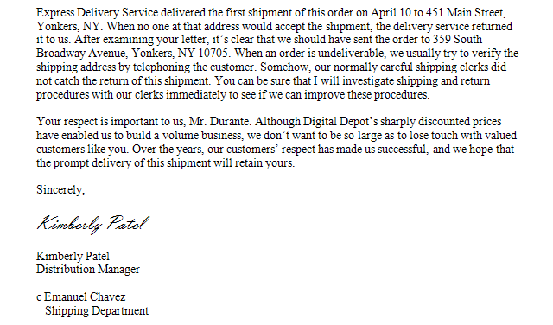
Adjustment Messages
Closing
  Show appreciation that the customer wrote.
  Consider expressing confidence that the problem has been resolved.
  Thank the customer for past business.
  Refer to your desire to be of service.

Slide 43
The Five Ss of Goodwill Messages
Selfless
Short
Specific
Five Ss
of Goodwill
Messages
Spontaneous
Sincere

Slide 44
The Five Ss of Goodwill Messages
In expressing thanks, recognition, or sympathy, discuss the receiver, not the sender.
Be selfless

Slide 45
The Five Ss of Goodwill Messages
In expressing thanks, recognition, or sympathy, cite specifics rather than generalities.
Be
specific

Slide 46
The Five Ss of Goodwill Messages
In expressing thanks, recognition, or sympathy, be sincere. Show your honest feelings with unpretentious language.
Be
Sincere

Slide 47
The Five Ss of Goodwill Messages
In expressing thanks, recognition, or sympathy, be spontaneous. Make the message sound natural, fresh, and direct. Avoid canned phrases.
Be
Spontaneous

Slide 48
The Five Ss of Goodwill Messages
In expressing thanks, recognition, or sympathy, keep the message short. Although goodwill messages may be as long as needed, they generally are short.
Keep it Short

Slide 49

Answering Congratulatory Messages
Send a brief note expressing your appreciation.
Tell how good the message made you feel.
Accept praise gracefully. Don’t make belittling statements. (I’m not really all that good!).
By John S. Donnellan

Slide 50
END

