Slide 1
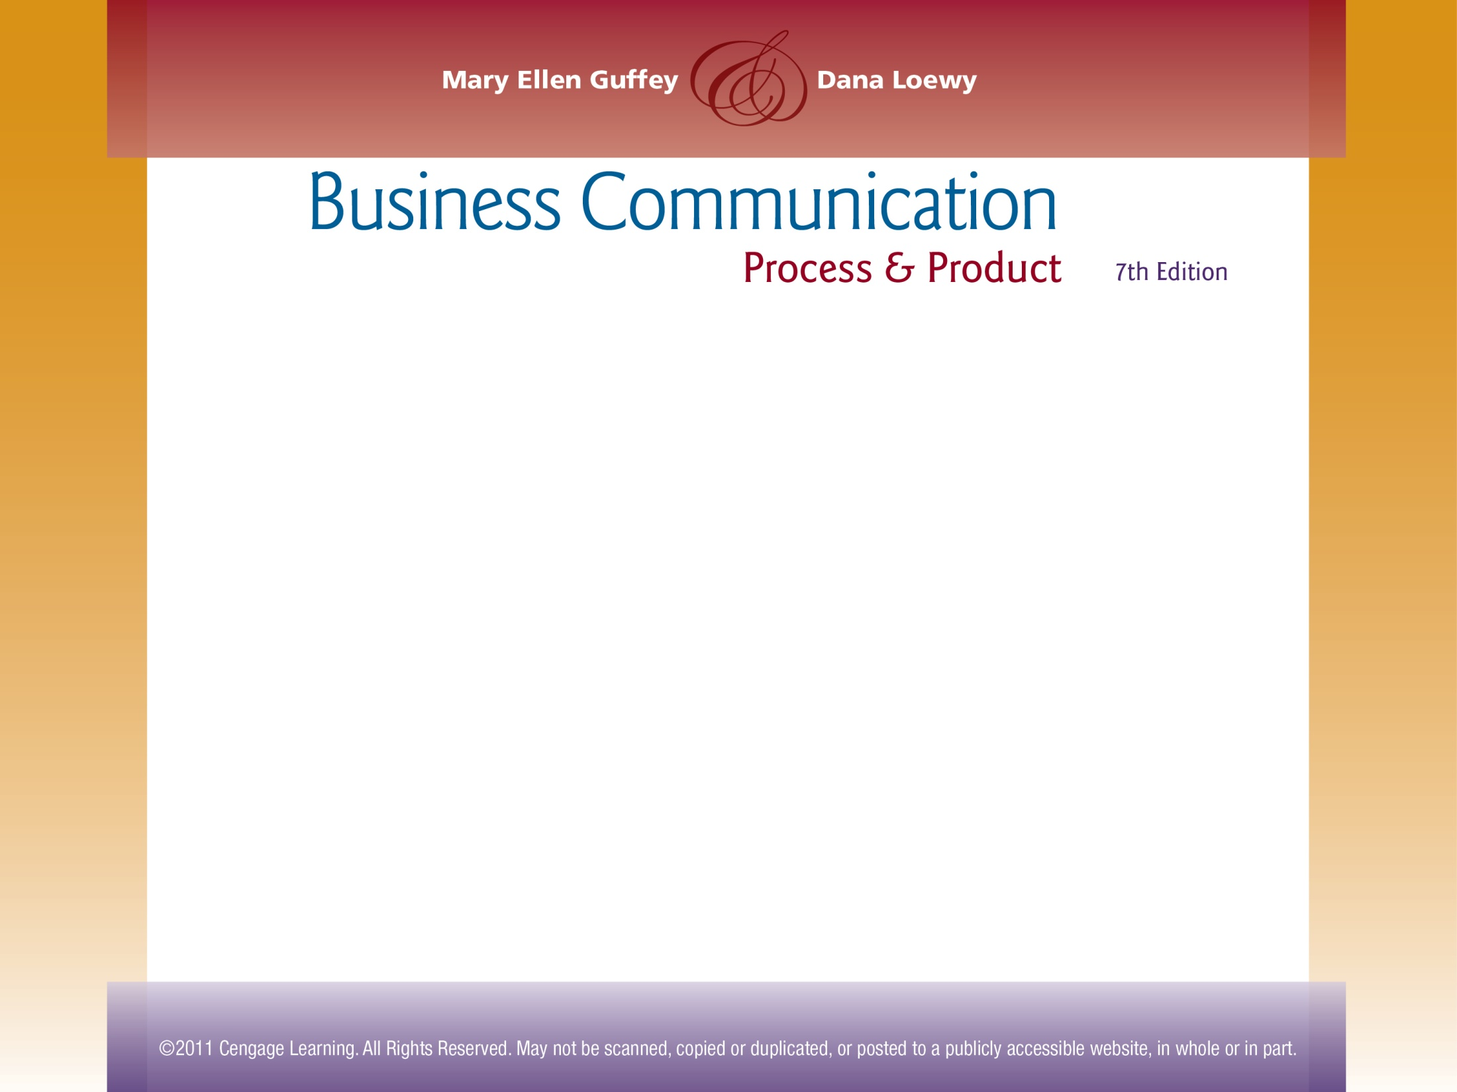

Chapter 9
Negative Messages

Slide 2
Topics in This Chapter
Goals in Communicating Negative News
Avoiding Legal Liability in Conveying Bad News
Direct Strategy for Delivering Bad News
Applying the 3-x-3 Writing Process for Negative Messages
Indirect Strategy for Delivering Bad News

Slide 3
Topics in This Chapter
Components of Effective Negative Messages
Dealing With Disappointed Customers
Managing Bad News on Social Networking Sites
Techniques for Delivering Bad News Sensitively
Announcing Rate Increases and Price Hikes
Delivering Bad News Within Organizations

Slide 4

Goals in Communicating Negative News
Explaining clearly and completely
Projecting a professional image of you and your organization
Conveying empathy and sensitivity
Being fair
Maintaining friendly relations

Slide 5
Applying the 3-x-3 Writing
Process to Negative Messages
Phase 1: Analyze, Anticipate, Adapt
  Analyze the bad news.
  Anticipate its effect on the receiver.
  Announce the bad news directly if the disappointment will be mild.
  Use techniques to reduce the pain if the bad news is serious.
1

Slide 6
Applying the 3-x-3 Writing
Process to Negative Messages
Phase 2: Research, Organize, Compose
  Gather information and brainstorm for ideas.
  Jot down all reasons you have to explain the bad news.
2

Slide 7
Applying the 3-x-3 Writing
Process to Negative Messages
Phase 2: Research, Organize, Compose
  Present only the strongest and safest reasons.
  Include ample explanation of the negative situation.
  Avoid fixing blame.
2

Slide 8
Applying the 3-x-3 Writing
Process to Negative Messages
Phase 3: Revise, Proofread, Evaluate
  Read the message carefully to ensure that it says what you intend.
  Check the wording to be sure you are concise without being abrupt.
  Read the sentences to see if they sound like conversation and flow smoothly.
3

Slide 9
Applying the 3-x-3 Writing
Process to Negative Messages
Phase 3: Revise, Proofread, Evaluate
  Make sure the tone is friendly and respectful to increase receiver acceptance.
  Check format, grammar, and mechanics.
  Evaluate the message. Is it too blunt? Too subtle? Is it clear, but professional?
3

Slide 10
Avoiding Legal Liability in
Conveying Negative News
Abusive language, including abusive language on social networking sites, such as Facebook and Twitter
Defamation - language that harms a person’s reputation
Slander -spoken defamation
Libel - written defamation

Slide 11

Avoiding Legal Liability in
Conveying Negative News
Careless language – statements that are potentially damaging or subject to misinterpretation
  For example, The factory is too hazardous for tour groups

Slide 12
Avoiding Legal Liability in
Conveying Negative News
The good-guy syndrome - dangerous statements that ease your conscience or make you look good
  For example, (I thought you were an excellent candidate, but we had to hire…)
  Express only the views of the organization when acting as an agent of the organization.
  Use plain paper for your personal matters.
  Avoid supplying information that could be misused.
  Don’t admit or imply responsibility without checking with legal counsel.

Slide 13
Comparing Strategies for
Delivering Negative News
Direct Strategy
Indirect Strategy
Bad News
Reasons
Pleasant Close
Buffer
Reasons
Bad News
Pleasant Close

Slide 14
When to Use the Direct Strategy
When the bad news is not damaging
When receiver may overlook the bad news
When the organization or receiver prefers directness
When firmness is necessary

Slide 15

When to Use the Indirect Strategy
When the bad news is personally upsetting
When the bad news will provoke a hostile reaction
When the bad news threatens the customer relationship
When the bad news is unexpected

Slide 16
Examining the Components of
Effective Negative Messages
Buffer
Reasons
Bad News
Closing
A neutral or positive opening that does not reveal the bad news
An explanation of the causes for the bad news
A clear but understated announcement of the bad news that may include an alternative or compromise
A personalized, forward-looking, pleasant statement

Slide 17
Techniques for Delivering
Bad News Sensitively
Buffering the Opening
Closing Pleasantly
Presenting the Reasons
Cushioning the Bad News
  Start with the part of the message that represents the best news.
  Pay a compliment, show appreciation for a past action, or refer to something mutually understood.
  Avoid raising false hopes or thanking the receiver for something you are about to refuse.
  Consider apologizing if you or your company erred. If you apologize, do so sincerely and take responsibility.

Slide 18
Techniques for Delivering
Bad News Sensitively
Buffering the Opening
Closing Pleasantly
Presenting the Reasons
Cushioning the Bad News
  Explain clearly why the request must be denied without revealing the refusal.
  Show how your decision benefits the receiver or others, if possible.
  Explain company policy without using it as an excuse.
  Choose positive words. Avoid negative words, such as cannot, claim, error, failure, unwilling, impossible.
  Show that the matter was treated seriously and fairly.

Slide 19
Techniques for Delivering
Bad News Sensitively
Buffering the Opening
Closing Pleasantly
Presenting the Reasons
Cushioning the Bad News
  Consider positioning the bad news strategically by sandwiching it between other sentences.
  Consider subordinating the bad news (although another commitment that day prevents me from attending, I wish you well in …).
  Consider using the passive voice (although I am prevented from attending because of another commitment that day, . . .).

Slide 20
Techniques for Delivering
Bad News Sensitively
Buffering the Opening
Closing Pleasantly
Presenting the Reasons
Cushioning the Bad News
  Accentuate the positive by describing what you can do, not what you can’t do.
  Consider implying the refusal, but be certain it is clear.
  Suggest a compromise or an alternative, if one exists.

Slide 21
Techniques for Delivering
Bad News Sensitively
Buffering the Opening
Closing Pleasantly
Presenting the Reasons
Cushioning the Bad News
  Look forward to future relations.
  Supply more information about an alternative, if one is offered.
  Offer good wishes, compliments, or freebies (coupons, samples, gifts).
  Avoid referring to the refusal.
  Use resale or sales promotion if appropriate.

Slide 22

Damage Control: Dealing
With Disappointed Customers
Call the individual involved.
Describe the problem and apologize.
Explain
  Why the problem occurred
  What you are doing to resolve it
  How you will prevent it from happening again
Follow up with a letter that documents the phone call and promotes goodwill.

Slide 23
“Before” – Ineffective
Customer Request Refusal
  Dear Ms. Trumbo:
  We regret to inform you that we cannot allow you to convert the lease payments you have been making on your Canon X1000 color copier toward its purchase, much as we would love to do so. We understand that you have been making regular payments for the past 16 months.
  Our established company policy prohibits such conversion of leasing monies. Perhaps you have noticed that we offer extremely low leasing and purchase prices. Obviously, these low prices would never be possible if we agreed to many proposals such as yours. Because we are striving to stay in business, we cannot agree to your request asking us to convert all 16 months of rental payments toward the purchase of our popular new equipment.
  It is our understanding, Ms. Trumbo, that you have had the Canon X1000 color copier for 16 months, and you claim that it has been reliable and versatile. We would like to tell you about another Canon model—one that is perhaps closer to your limited budget.
  Sincerely,

Slide 24

Critical Thinking Questions
What is the purpose of the letter on the previous slide? What goals should the sender have?
What prevents this letter from achieving those goals?
What pattern of development would work best for this letter? Is that pattern what you see?

Slide 25
Critical Thinking Questions
What idea could serve as a buffer to open an improved version of this letter? Write a buffer.
How could the bad news be subordinated? Write a statement that subordinates the bad news.
What friendly news could be used in the closing? Write a closing statement.

Slide 26
“After” – Improved Refusal of Request
  Dear Ms. Trumbo:
  We’re happy to learn that you are enjoying the use of the Canon X1000 color copier you’ve been leasing for the past 16 months.
  Like our many other customers, Ms. Trumbo, you have discovered that Canon copiers supply remarkable versatility and reliability. One of the reasons we’re able to offer these outstanding copiers at such low leasing rates and equally low purchase prices is that we maintain a slim profit margin. If our program included a provision for applying lease payments toward purchase prices, our overall prices would have to be higher. Although lease payments cannot be credited toward purchase price, we can offer you other Canon models that are within your price range. The Canon 600 delivers the same reliability with nearly as many features as the top-of-the-line Canon X1000.
  Please let us demonstrate the Canon 600 to your staff in your office, Ms. Trumbo. Our representative, Seth Simmons, will call you during the week of May 5 to arrange an appointment.
  Sincerely,

Slide 27

Managing Organizational Negative News on Facebook, Twitter, and Other Web Sites
Recognize social networks as an emerging communication channel.
Become proactive by establishing blogs and active Web sites with community forums to listen to customers and advertise the company's good deeds.

Slide 28
Managing Organizational Negative News on Facebook, Twitter, and Other Web Sites
Join sites, such as Twitter, Facebook, Flickr, YouTube, and LinkedIn to see how these sites function and to benefit from site interaction.
Monitor comments about your organization to make immediate response possible.
By John S. Donnellan

Slide 29
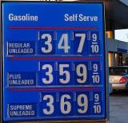
Announcing Rate Increases and Price Hikes
Explain the reason for the price increase, such as higher material costs or rising taxes.
Convey how the increase will add new value or better features, make use more efficient, or make customers’ lives easier.
Give (advance) warning of rate increases.

Slide 30
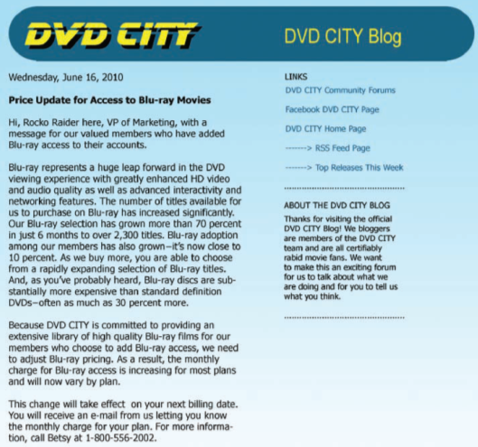
In Today’s Digital Environment, Rate and Price Increases May Be Announced Online
Explains expansion of Blu-ray DVD movie collection and describes how costly these films are, thus justifying a price increase
Connects increase in cost to bigger library and wider choice of best movies for customers

Slide 31
In Today’s Digital Environment, Rate and Price Increases May Be Announced Online
Provides name and number for more information

Slide 32
Techniques for Delivering
Bad News Personally to a Superior
Gather all the information.
Consider taking a colleague with you.
Prepare and rehearse.
Explain what happened and how the problem will be repaired.
Think about timing.
Be patient with the reaction.

Slide 33
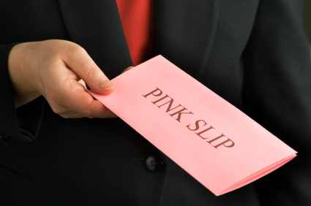
Techniques for Delivering Bad News to Groups of Employees
Deliver the news honestly and early.
Use the indirect strategy.
Try to open with a relevant, upbeat buffer.
Provide clear, convincing reasons that explain the decision.
Be clear, yet kind, gentle, and understated with the bad news.
Avoid referring to the bad news in the closing.

Slide 34
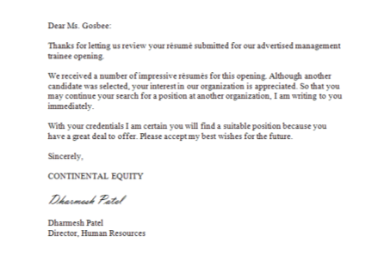
Techniques for Refusing Job Applicants
To avoid being painful to the receiver and, more importantly, to avoid providing extra information that may prove fatal in a lawsuit, keep letters short, general, and tactful.

Slide 35
End

